Slide 1

Salary Prediction
With machine learning

Slide 2
The Process
Define
Discover
Develop
Deploy
This four step process is provided to guide the data science team through the project

Slide 3
Define
Define
Discover
Develop
Deploy
We would like to predict the salary of jobs based solely on job descriptions:
Job Type: CEO, Senior,…
Degree: Bachelor, Master’s,...
Industry: Oil, Web, Finance,…
Years of Experience required,
and more

Slide 4
Data and Approach
Train Features
Test Features
Train Salaries
Predict Salaries
The predicted salary can :
inform decisions on offer packages
help with employee retention of highly performing employees

Slide 5
Discover
Define
Discover
Develop
Deploy
The data cleaning was simple in this project:
There are no duplicated rows
There are no missing or corrupted data
There are 5, out of 1 million rows, where salary is zero
These rows were dropped

Slide 6
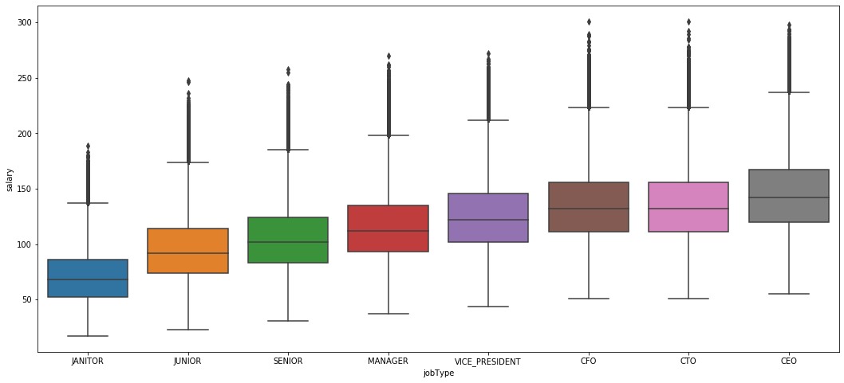
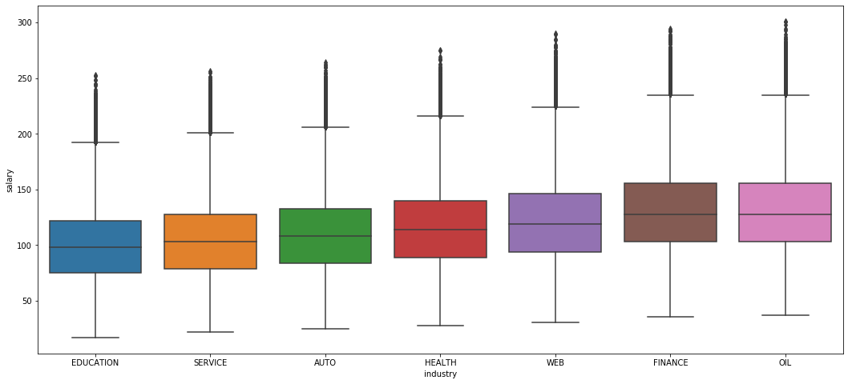
Discover
C-suite jobs are the highest paying jobs
Finance and Oil jobs are on demand

Slide 7
Baseline Model
Using this insight, a simple model was developed as a baseline
The predicted salary would be the average salary by job type
Baseline Model MSE: 965

Slide 8
Mean Squared Errors (MSE)
MSE is a metric calculating how far off our predictions are from the real values
Visually, MSE captures the distance between the blue dots and the red line
the closer the blue dots are to the red line, the lower MSE will be

Slide 9
Develop
Define
Discover
Develop
Deploy
Three models were developed
Linear Regression
Random Forest Regression
Gradient Boosting Regression

Slide 10
Feature Engineering
It’s how the data is put together that they become more useful
From education and experience => guess their age
Executive level jobs are grouped together (CEO, CFO, CTO)
Jobs that are on demand are grouped together (Oil and Finance)

Slide 11
Models’ Result
The tuned models greatly outperformed the baseline model, cutting errors in half

Slide 12
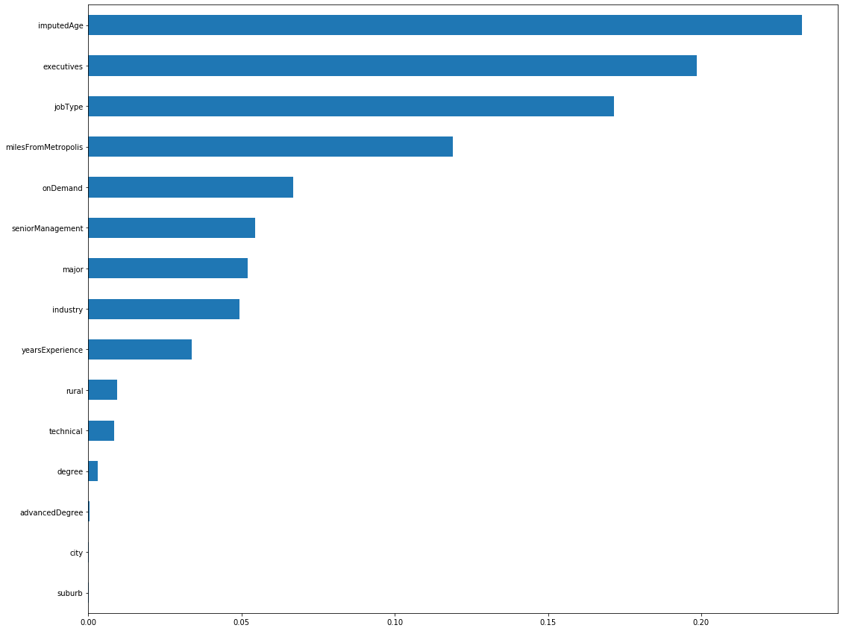
What’s Important
The best model produces a report on which feature is most helpful at predicting salaries.
Best four (explains over 70%):
age
job type
whether the job is at the executive level
how far is the job from a major city

Slide 13
What’s Important
The next 25% is explained with:
whether the job is in Oil or Finance
whether the job is at the Senior Management level
major
industry

Slide 14
Deploy
Define
Discover
Develop
Deploy
A pipeline was developed to automatically :
load and clean data
perform feature engineering
train models and select the best performing model
using the best model to predict salary on the test dataset

